Slide 1


Optimising F1 in Schools Car Design Using CFD Simulation and Wind Tunnel Testing for Enhanced Aerodynamic Performance
Engineering Without Borders:
Towards a Sustainable Future
TAMU Hotel & Suites
Kuala Lumpur
13th-15th September 2026
*Hanif Muhammad, Ramlan Kasiran
Faculty of Mechanical Engineering, UiTM , Shah Alam, Malaysia
Mohamad Jasri Fuad
Faculty of Mechanical Engineering, UZM, Sibu, Malaysia

Slide 2
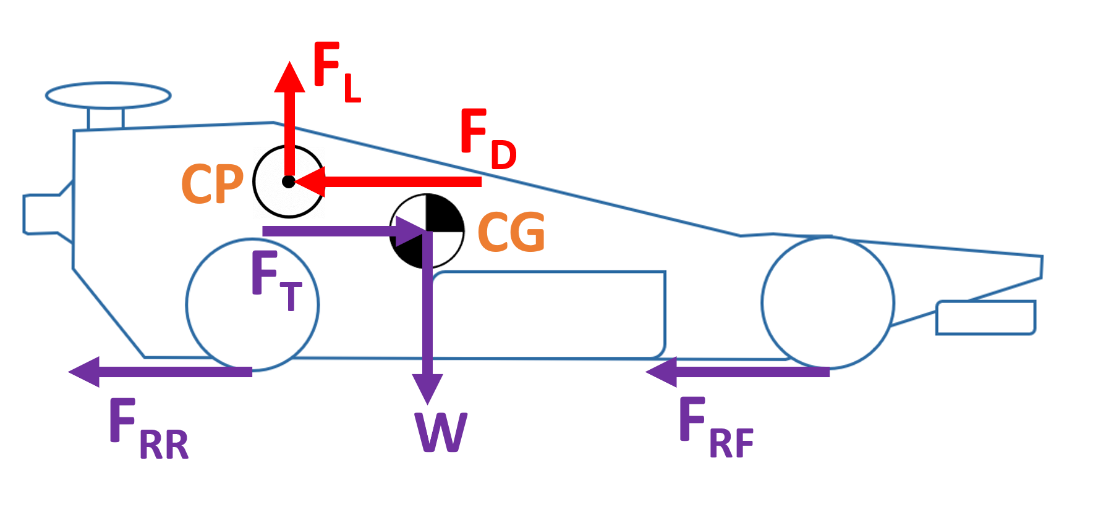
Abstract
the design must be optimised to reduce drag
various design iterations were evaluated through CFD simulations,
wind tunnel experiment was conducted to verify the results
modifications significantly reduced drag force by 9.89%.
enhancements could involve analysing pressure distribution and lift force to maximise thrust utilisation and improve race performance.

